Slide 1
Sequence Diagrams and introduction to UML
COMP 3711
Larman: Chapter 10

Slide 2
The UML Diagrams
Class
Sequence
Activity
State
Object
Use Case
Collaboration
Component
Deployment

Slide 3
Sequence Diagrams in the Elaboration Phase
Sequence diagrams are used in elaboration phase after decision is made to continue with serious investigation.

Slide 4
During Elaboration - Iteration 1
  Tackle a simple success scenario.
  Target design and implementation that touches on many major architectural elements of the new system.
  Skip tasks related to environment (e.g. tools, people, processes, and setting).
  Clarify input and output system events related to system with UML sequence diagrams.

Slide 5
System Sequence Diagram (SSD)
A fast and easily created artifact that illustrates input and output events related to the system under discussion.
A picture that shows, for a particular scenario of a use case, the following:
  Events that external actors generate
  Their order
  Inter-system events

Slide 6
System Sequence Diagram (SSD)
An SSD should be done for:
  Main success scenarios
  Frequent or complex alternative scenarios
An SSD should take few minutes to ½ hour

Slide 7
From use cases to sequence diagrams
Use cases describe how external actors interact with the software system
  Actor generates events to a system
  Event initiates an operation upon the system
UML includes sequence diagrams as a notation that illustrates actor interactions and operations initiated by them
Example:
The Cashier
Generates Event ➔ request POS system to record item sale
Initiates Operation ➔ makeNewSale()

Slide 8
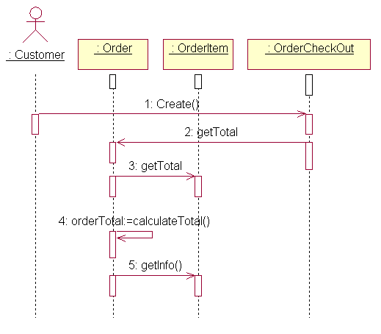
Sequence Diagram Symbols & Notations
What is a UML Sequence Diagram?
Sequence diagrams describe interactions among classes in terms of an exchange of messages over time.

Slide 9
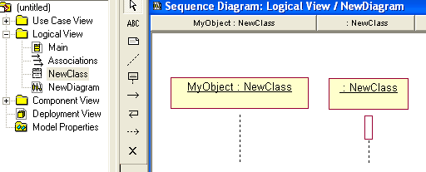
Class Roles
Class roles – “MyObject” - describe the way an object will behave in a context. Use the UML object symbol to illustrate class roles, but don't list object attributes.

Slide 10
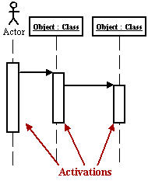
Activation
Activation boxes represent the time an object needs to complete a task.

Slide 11
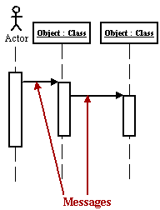
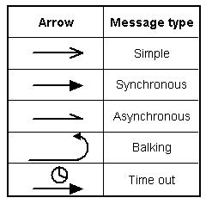
Messages
Messages are arrows that represent communication between objects.
Order in which messages occur are shown top to bottom on the page
Use half-arrowed lines to represent asynchronous messages. Asynchronous messages are sent from an object that will not wait for a response from the receiver before continuing its tasks.

Slide 12
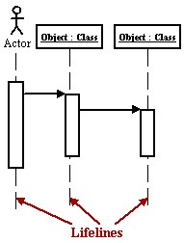
Lifelines
Lifelines are vertical dashed lines that indicate the object's presence over time.

Slide 13
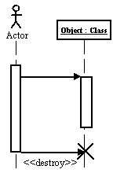
Destroying Objects
Objects can be terminated early using an arrow labelled "< < destroy > >" that points to an X.
Notes:
http://www.smartdraw.com/resources/centers/uml/uml4.htm#whatseq

Slide 14
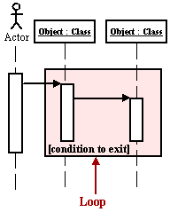
Loops
A repetition or loop within a sequence diagram is depicted as a rectangle. Place the condition for exiting the loop at the bottom left corner in square brackets [ ].

Slide 15
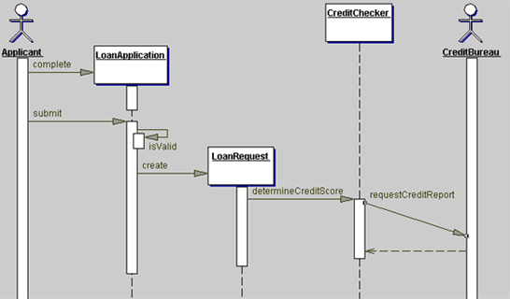
More on Seq. Diagram UML notations
You can show a “self-call’, which is a message that an object sends to itself
Return messages differ from regular messages in that the line is dashed. Return messages are not normally drawn as they clutter diagrams.
Each message is labeled at a minimum with the message name. You can also include arguments.

Slide 16
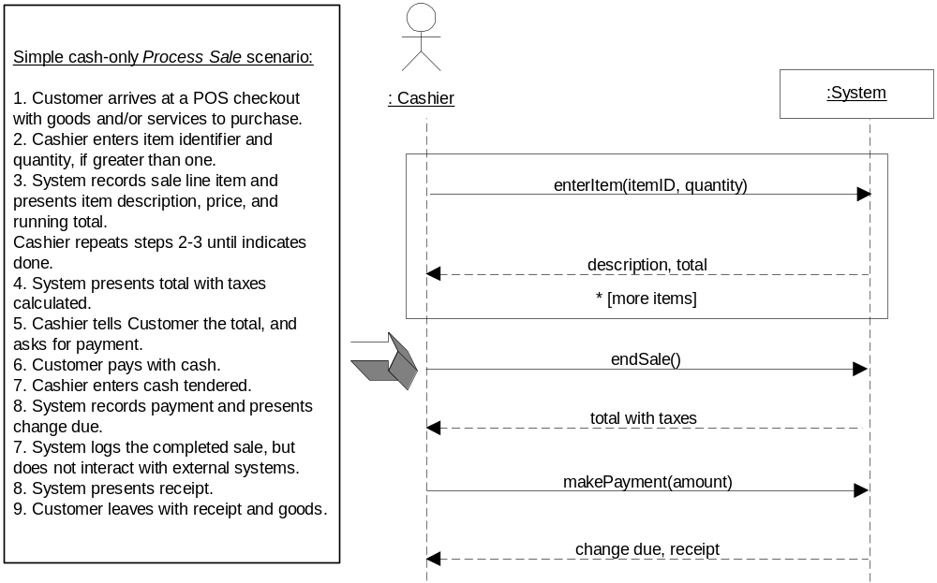
Use cases to Sequence Diagrams
Sequence diagram shows events for a use case scenario

Slide 17
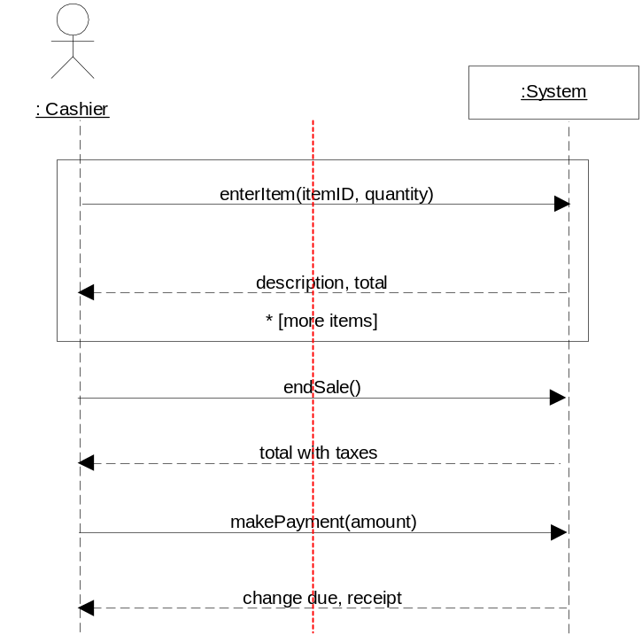
Identify Boundary Classes
System boundary
It is necessary to be clear on the choice of system boundary
The system boundary is usually chosen to be the software system itself.

Slide 18
Naming system events and operators
Express events and operations at the level of intent rather than in terms of physical input medium
Start event names with a verb:
  addXXX
  enterXXX
  endXXX
  makeXXX ….
enterItem better than scan

Slide 19
More on sequence diagrams …
Typically, object that initiates interaction is placed at the left.
Increasingly, more subordinate objects are placed to the right.

Slide 20
More on sequence diagrams …
Objects can be created during an interaction with receipt of stereotype <<create>>.
Objects can be destroyed during an interaction with receipt of stereotype <<destroy>>.

Slide 21
Phases
Inception: usually no sequence diagrams
Elaboration:
  Most sequence diagrams are created during elaboration
  Useful for identifying details of the system events
  Not necessary to create sequence diagrams for all use case scenarios
Phases

Slide 22
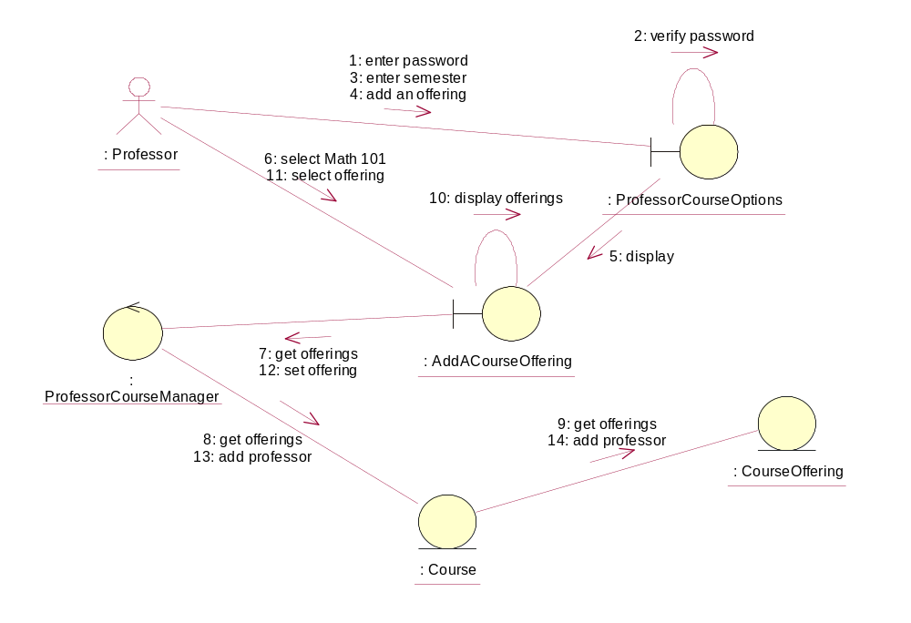
Collaboration diagrams
Have a 1:1 correspondence with seq. diagrams
No lifeline of an object

Slide 23
Questions and Conclusions

